Slide 1
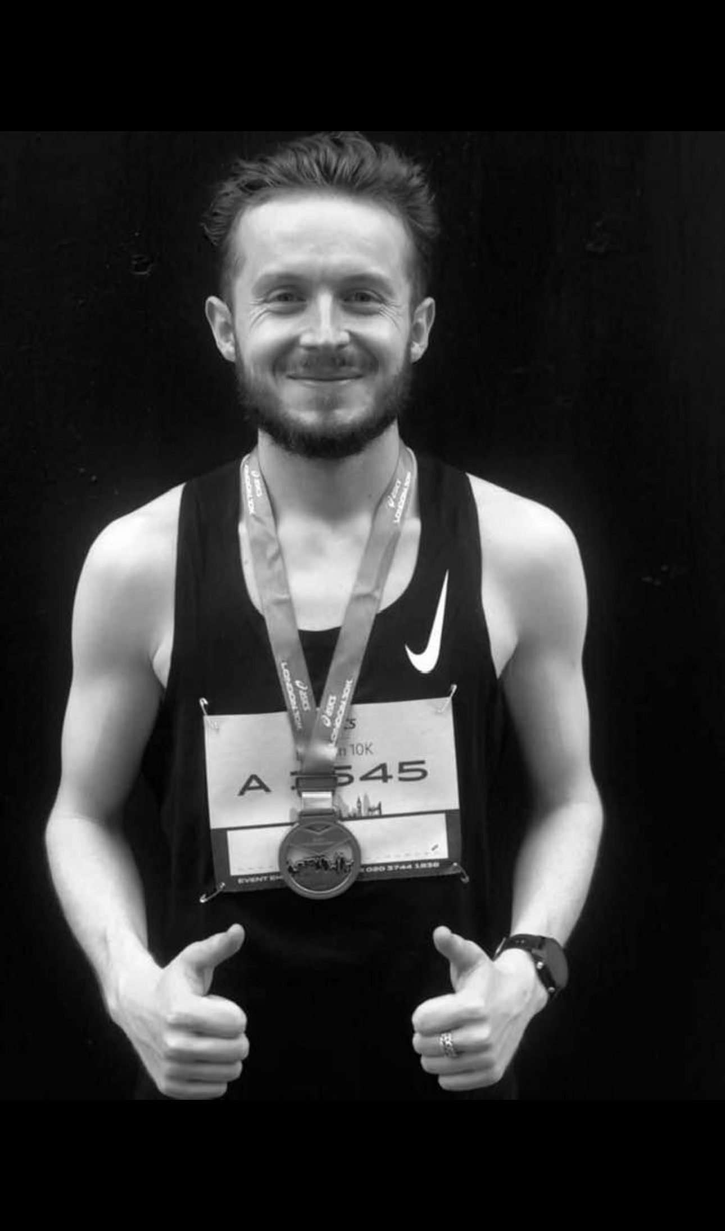
Sean Joyce
July 1995 - August 2021
Undetected heart defect.

Slide 2
Athletes face reactive heart health management
- compromising:
Performance
Recovery
Optimal Health
Notes:
in 2021 my step-brother sean passed away from cardiac arrest at the age of just 26 whilst out on a run This I strongly believe was a result of suboptimal, realtime heart monitoring which compromised his health and ultimately his life We have seen this in professional sports to, with reactive health management and lack of advanced insights, leaving athletes vulnerable and not at their peak levels

Slide 3

CONFIDENTIAL
AARON GOTLASETH - CEO & FOUNDER

Slide 4
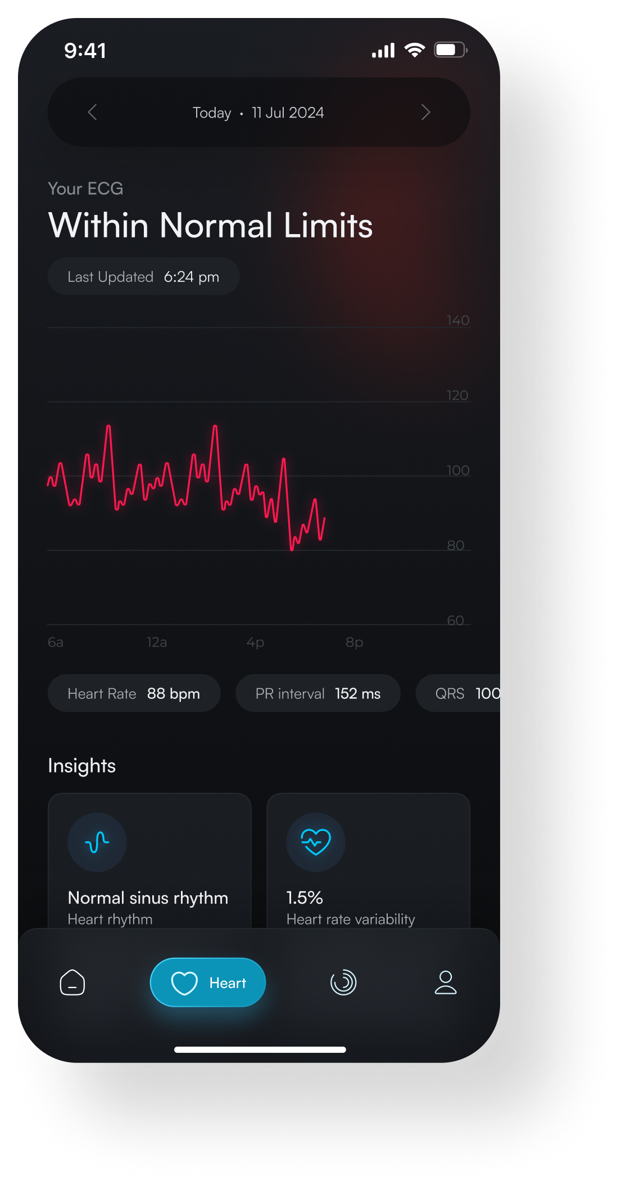
OUR MISSION
Provide:
Real-time insights
Proactive heart health management
Peak performance
CONFIDENTIAL
Notes:
Our aim is to provide an continuous heart health monitoring platform to athletes of all levels We want to provide them with real time insights through our AI driven data Which in turn, will allow them to manage their health proactively and perform to their peak

Slide 5
WHAT WE ARE
AI Software company
Heart health analytics
WHAT WE ARE NOT
Hardware manufacturer
Notes:
We would like to thank you both for inviting us and giving us the time to present our vision to you today! We are very excited for the potential of EXRT!

Slide 6
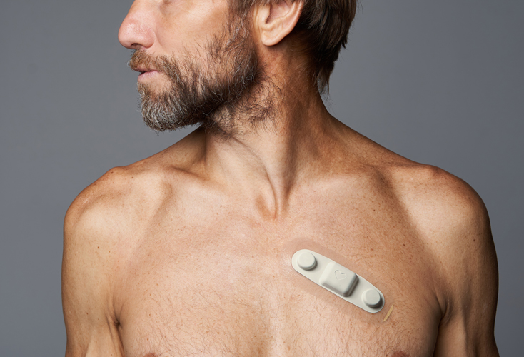
HOW?
3RD PARTY DEVICE
ATTACHES TO THE CHEST
ADHESIVE PATCH
Notes:
We would like to thank you both for inviting us and giving us the time to present our vision to you today! We are very excited for the potential of EXRT!

Slide 7

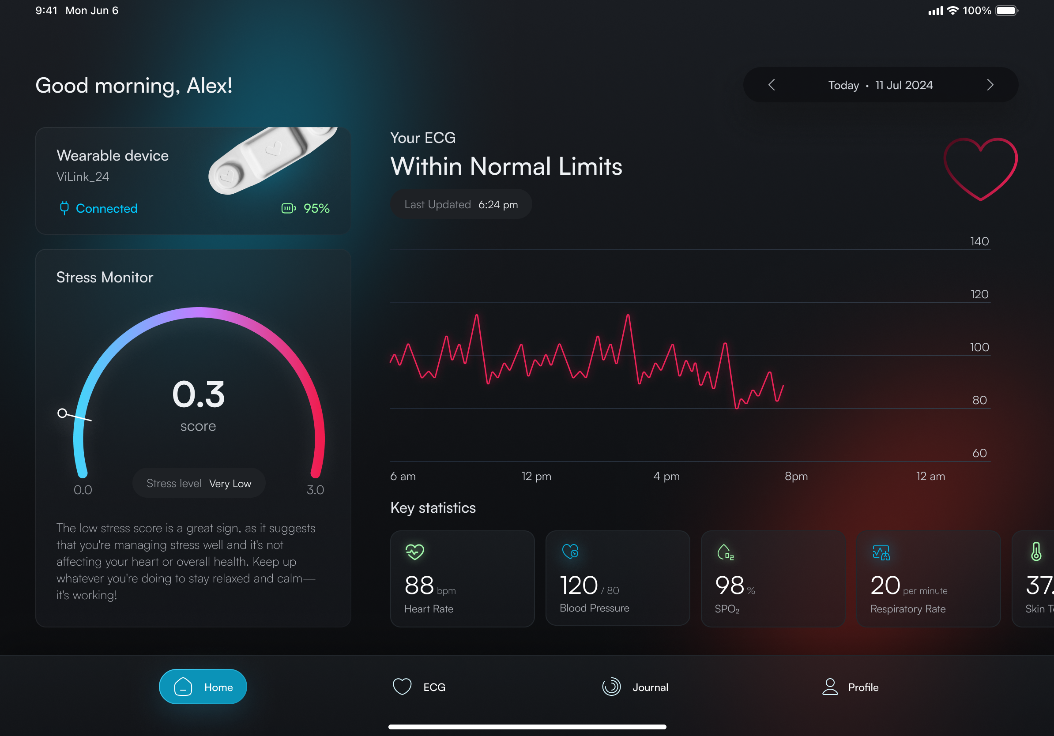
SOFTWARE
CONFIDENTIAL
Device Integration
Notes:
POC of dash At a glance STress monitor ECG monitor Key perfonce indicators nav bar

Slide 8
SOFTWARE
CONFIDENTIAL
Device Integration
ECG Monitor
Notes:
POC of dash At a glance STress monitor ECG monitor Key perfonce indicators nav bar

Slide 9
SOFTWARE
CONFIDENTIAL
Device Integration
ECG Monitor
Stress Monitor Scale
Notes:
POC of dash At a glance STress monitor ECG monitor Key perfonce indicators nav bar

Slide 10
SOFTWARE
CONFIDENTIAL
Device Integration
ECG Monitor
Stress Monitor Scale
Key Performance
Metrics
Notes:
POC of dash At a glance STress monitor ECG monitor Key perfonce indicators nav bar

Slide 11
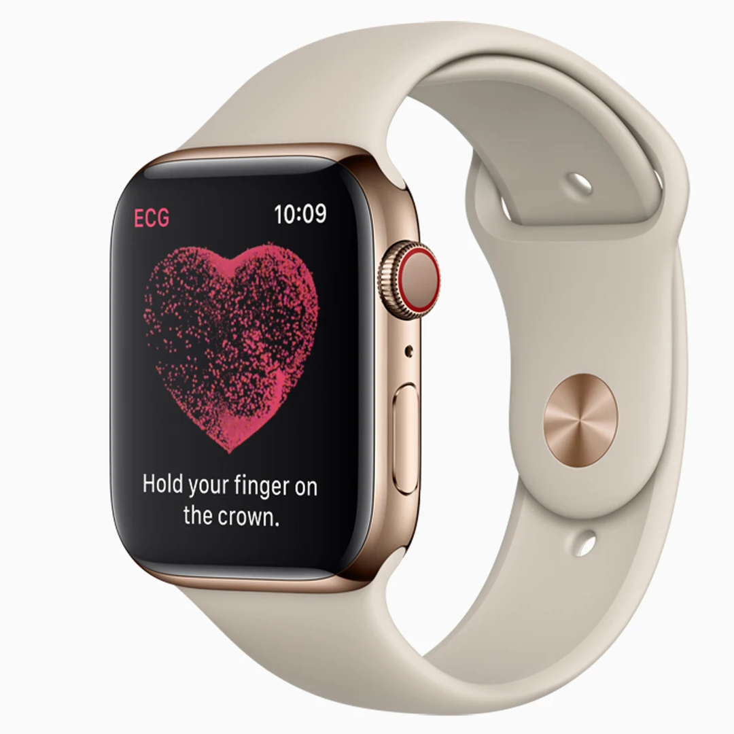
Don't I get all this?
Notes:
Essential heart health monitoring - performance, recovery & optimal health ECG chest patch FDA approved heart monitoring 14days on a charge allows continous monitoring studies show continious monitoring, give up to 93% reductiion cardiac risk. Real time physiological data for training and recovery personalisation push notifs if abnormality or cardiac issue AI driven heart insights, decreasing risk and improving performance and prediction

Slide 12
Spot check
Not continuous
PPG sensors & not custom fit
Can't be worn in competitive scenarios
Notes:
Essential heart health monitoring - performance, recovery & optimal health ECG chest patch FDA approved heart monitoring 14days on a charge allows continous monitoring studies show continious monitoring, give up to 93% reductiion cardiac risk. Real time physiological data for training and recovery personalisation push notifs if abnormality or cardiac issue AI driven heart insights, decreasing risk and improving performance and prediction

Slide 13
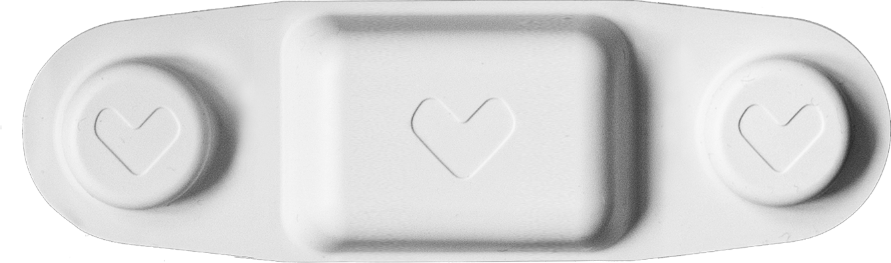
CONFIDENTIAL
Features
Benefits
Data Parameters
Rechargeable up to 14 days
Up to 30 day data cache
IPX7 water resistance
Connects via BLE network
Live Streaming & recording
Reusable & rechargeable with case
IoT-enabled
Ultra light and non-evasive
ECG rhythm
Heart rate
Heart rate variability
RR-interval
Respiratory rate
Skin temperature
Step count
Posture
3-Axis accelerometer
Notes:
ICC of 0.97 against benchmark Medical grade Rechargeable - 14 days waterproof, great for sweating athletes 30 day cache, if connection lost will still record data and sync to cloud when online Connects via bluetooth Non evasive and light

Slide 14
Reduce cardiac risk by 93%
Notes:
Essential heart health monitoring - performance, recovery & optimal health ECG chest patch FDA approved heart monitoring 14days on a charge allows continous monitoring studies show continious monitoring, give up to 93% reductiion cardiac risk. Real time physiological data for training and recovery personalisation push notifs if abnormality or cardiac issue AI driven heart insights, decreasing risk and improving performance and prediction

Slide 15
Improve performance, through prediction and prevention up to 30%
Notes:
Essential heart health monitoring - performance, recovery & optimal health ECG chest patch FDA approved heart monitoring 14days on a charge allows continous monitoring studies show continious monitoring, give up to 93% reductiion cardiac risk. Real time physiological data for training and recovery personalisation push notifs if abnormality or cardiac issue AI driven heart insights, decreasing risk and improving performance and prediction

Slide 16
CONFIDENTIAL
WHY EXRT?
First to market with AI-driven heart health monitoring specifically for athletes.
Ability to continuously assess vital signals,
AI & ML models can detect subtle physiological signatures

Slide 17






GRANULAR HEART INSIGHTS
COMPETITOR MATRIX
EXRT AI
CONTINUOUS MONITORING
FOURTH FRONTIER
WHOOP
GARMIN
OURA
FITBIT

Slide 18
MARKET OPPORTUNITY
TOTAL
ADDRESSABLE MARKET
$265.4B
TAM
SERVICEABLE
ADDRESSABLE MARKET
$18B
SAM
TARGET MARKET
TARGET MARKET
$1.5B
MARKET
SHARE
$550M
EXRT MARKET SHARE

Slide 19
ADDITIONAL VERTICAL OPPORTUNITIES
Healthcare
Business & Insurance

Slide 20








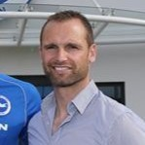

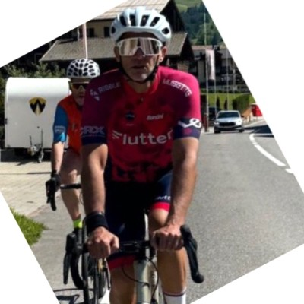
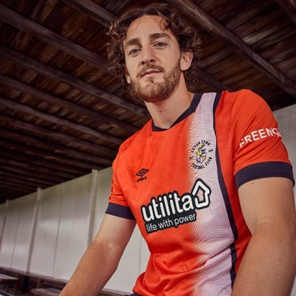
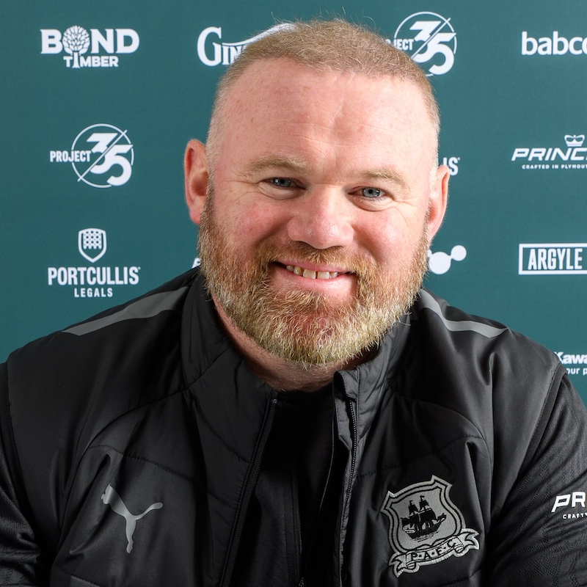
INTEREST & CONNECTIONS
PAUL WINSTANLEY
CO-SPORTING DIRECTOR
CHELSEA FC
JONATHAN POWER
CLUB DOCTOR
LIVERPOOL FC
MARK GILLETT
CHIEF MEDICAL OFFICER
PREMIER LEAGUE
TOM LOCKYER
FOOTBALLER
CARDIAC ARREST VICTIM
WAYNE ROONEY
ENGLAND& MAN UTD LEGEND

Slide 21




GO-TO-MARKET
Phase One
Beta Test & Initial Validation (2025 Current)
Phase Two
MVP Development & Iteration
(2025 3 months)
Phase Three
Early Market Penetration & Branding (2026 8 months)
Phase Four
Scaling Sales & Market Expansion (2026 14 months)

Slide 22
BUSINESS MODEL
Pricing strategy
Annual SaaS revenue, Monthly device payment.
User Type | Device Cost | Software Fee | Analytics
High-Tier Pro Teams | £300 per player | £15-30,000 Annually | Advanced heart analytics+£2000
Low-Tier Pro Teams | £150 per player | £5-15,000 Annually | Mid Tier heart analytics+£1000
Consumers | £250(one time) OR | £65 per month all inclusive | Analytics add on - £30 Premium Tier Monthly
Notes:
Higher tier teams = more revenue more premium metrics

Slide 23
FINANCIAL MODEL
 | 2025/2026 | 2026/2027 | 2027/2028 | 2028/2029 | 2029/2030
No. of Teams | 40 | 118 | 393 | 987 | 1,984
Revenue | £1,200,000 | £3,558,000 | £11,727,200 | £29,635,650 | £59,520,000
Gross Profit (65%) | £780,000 | £2,346,393 | £7,622,760 | £19,263,789 | £38,688,000
Net Profit (20%) | £240,000 | £711,600 | £2,345,440 | £5,927,130 | £11,904,000
Notes:
Higher tier teams = more revenue more premium metrics

Slide 24
FINANCIAL MODEL
 | 2026/2027 | 2027/2028 | 2028/2029
No. of Consumers | 2,573 | 39,684 | 197,120
Revenue | £2,007,540 | £30,950,520 | £153,753,600
Gross Profit (31%) | £624,347 | £9,629,661 | £47,915,865
Net Profit (15%) | £301,131 | £4,642,578 | £23,063,040
Notes:
Higher tier teams = more revenue more premium metrics

Slide 25
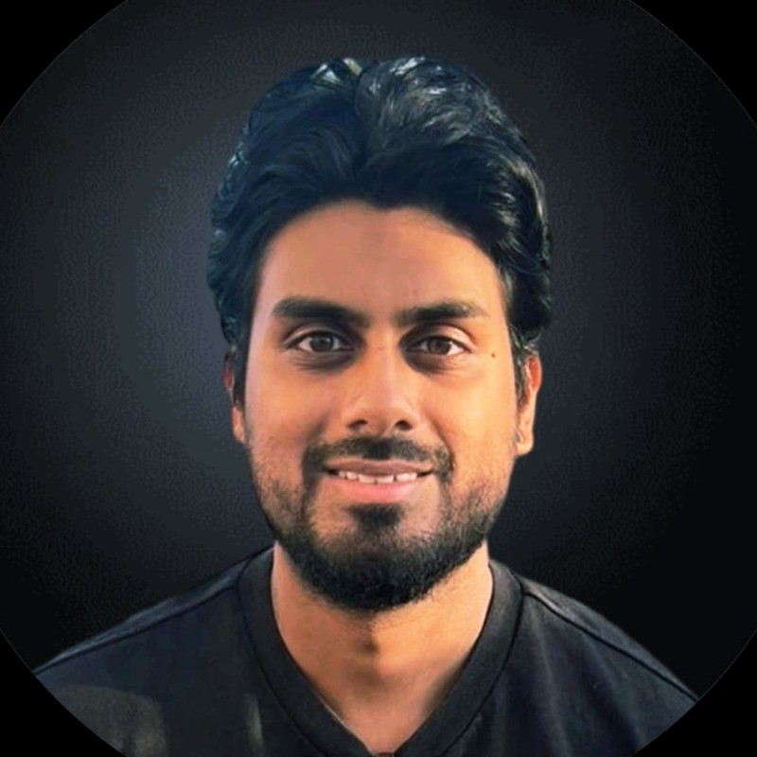

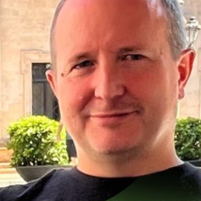
OUR TEAM
Aaron Gotlaseth
James Smethurst
Sean Gilmour
CHIEF EXECUTIVE OFFICER
(TECH & ENTERPRISE SALES)
CHIEF OPERATING OFFICER
RECRUITMENT, AI ENTREPRENEUR
CHIEF TECHNOLOGY OFFICER
(AI ENGINEERING)

Slide 26
CONFIDENTIAL
93% Reduction in Cardiac Risk
​
Performance improvement up to 30%
$550m Market Share
​
Validated Technology with Medical-Grade Accuracy
​
Experienced, Visionary Team and Strong Partnerships
​

